Slide 1
Updated Title IX Process
Spring 2021

Slide 2
Overview of Session
Changes to Title IX
Roles and Responsibilities
In-depth Review of Policies and Procedures
Title IX
Non-Title IX
Next Steps

Slide 3
What has changed?
Regulations—no longer guidance
More narrow, specific definition of what falls under TIX
Requires a formal complaint to enact Title IX process
Colleges must provide the parties with equal access to inspect and review the evidence

Slide 4
What has changed?
Investigator must submit an investigation report summarizing the relevant evidence to decision maker
Hearing and “live” cross examination
Very specific rules of evidence and defined procedures
Unable to use any statements if a person refuses to be subjected to cross examination

Slide 5
In-depth Review of Policies and Procedures
2.01.19 Prohibition of Sexual Discrimination and Sexual Harassment (Title IX Allegations)
2.01.19.00 Procedure (general)
2.01.19.01 Advisors
2.01.19.02 Grievance
2.01.19.03 Appeal
2.01.01 Prohibition of Sexual Discrimination, Harassment and Interpersonal Misconduct (Non-Title IX Allegations)

Slide 6
Pre-Investigation
Report received by TIX Coordinator or Deputies
TIX Coordinator evaluates
Title IX Coordinator/Deputy Coordinator roles
TIX Coordinator:
Tracy Morris
Deputy Coordinators:
Cynthia Vasquez-Barrios
Judy Connelly
Mary Beth Luna
Meet explain options/supportive measures
If no formal complaint/does not meet criteria, TIX process ends
If formal complaint, process begins

Slide 7
Roles and Responsibilities
Title IX Coordinator
(8-10 hours of Annual training required 110 ILCS 155/25(b) and 30(c))
Intake of all complaints and initial documentation, including outreach to complainant in accordance with 2.01.19
Gate-keeper function for informal review
Communicate/enact interim measures to both parties
Determine the need for campus-wide communications/evaluate requests for confidentiality
Ensure completion of required training for Title IX team, campus, and students
Assignment of Investigators and/or Deputy to cases

Slide 8
Roles and Responsibilities
Title IX Coordinator (continued)
Monitor timely completion
Review findings and make determination
Communicate final determinations to both parties and provide information related to appeal process
Monitor changes to federal and state law/statute/regulations and communicate changes to Design Team and Investigators as needed
Should not investigate cases-only provide oversight

Slide 9
Roles and Responsibilities
Title IX Deputies
(8-10 hours of Annual training required 110 ILCS 155/25(b) and 30(c))
Serve on Hearing Board—not as Chair—if not involved in complaint or preliminary review
May be an initial intake for a complaint-which will be routed to the Title IX Coordinator for assignment
Assist with assignment of investigators/determining interim measures, where needed
May provide assistance to investigators during investigation/development of questions **
May conduct investigations in select circumstances**

Slide 10
Roles and Responsibilities
Title IX Investigators
(8-10 hours of Annual training required 110 ILCS 155/25(b) and 30(c))
Conduct investigations as assigned, individually or in a team
Presents information gathered in alignment with Title IX. Does not make assessment on complaint.
Present findings and information to the Hearing Board in alignment with Title IX
Submit required documentation into Maxient

Slide 11
Roles and Responsibilities
Title IX Appellate
(Annual training required 110 ILCS 155/25(b) and 30(c))
Satisfies 1 level of appeal best practice
Defined in 2.01.19.04
Both parties have the opportunity to appeal to the Appellate-in select situations
Should not investigate cases
Review policy/procedure change recommendations for approval (with Title IX Coordinator)

Slide 12
Roles and Responsibilities
Advisors
Both parties are entitled to have an advisor present during any meetings regarding the process.
The advisor's function is defined in 2.01.19.01.
During meetings and hearings, the advisor may talk quietly with the student or pass notes in a non-disruptive manner.
The advisor must ask the cross-examination questions in a Title IX process.
The advisor may not, in any way, intervene in the meeting/hearing or address the investigator/ hearing board.
The advisor cannot be someone who has a current formal role (e.g., academic advisor, coach, faculty member) with either the respondent or complainant.

Slide 13
Roles and Responsibilities
Hearing Officer
In Title IX cases, the hearing board will consist of 2 individuals who will work with the Hearing Board Chair.
The Chair may be an outside entity with specialized training in the rules of evidence, questioning, etc.
Hearing Board members will be present at any hearings to hear and review all evidence. Members will provide input to the Hearing Board Chair, who will ultimately make the decision and recommend the sanctions.

Slide 14
Questions?

Slide 15
Walk through Policy
Definitions
Jurisdiction
Reporting Processes
If it does not meet these thresholds, must dismiss under TIX
Dismissal under TIX does not mean the allegations can’t be investigated/processed under 2.01.01

Slide 16
Walk through Procedure (general)
Supportive measures to both parties
non-disciplinary, non-punitive individualized services offered as appropriate, as reasonably available, and without fee or charge
designed to restore or preserve equal access for all parties to their educational program or employment without unreasonably burdening the other party and to protect the safety of all parties, and to deter sexual harassment
Suspensions are to be used only in limited situations

Slide 17
Walk through Procedure (Advisors)
Available to both parties at all meetings
Must have an advisor at hearing-advisor must cross-examine
May be from JJC or outside of JJC
Rules are the same for all advisors/will be given a document at the time advisor is determined
Can’t speak for the party—each party must answer for themselves at all phases of process

Slide 18
Walk through Procedure (Grievance Process)
Notifications
Timelines
Investigation
Hearing
Live and real-time
Can be virtual
Hearing Officer rules on each question before answered

Slide 19
Walk through Procedure (Grievance Process) continued
Preponderance of the Evidence standard
Hearing Board provides input
Determination made by Hearing Officer
Sanctions (if applicable) determined in conjunction with institutional representative
Timelines/Notices

Slide 20
Walk through Procedure (Appeals)
Timelines are important
An appeal must be based on one or more of the following grounds:
1. A procedural irregularity occurred;
2. New evidence or information exists that could affect the outcome of the matter;
3. The Title IX Coordinator, Investigator or Hearing Officer had a conflict of interest or bias for or against complainants or respondents generally, or the individual Complainant or Respondent, that affected the outcome of the matter; and/or
4. The sanction is disproportionate with the violation.

Slide 21
Next Steps
Continued training opportunities (summer/fall) both virtual and on-demand
In the case of an allegation, materials and support will be provided
Presidential Changes will not have a quick impact

Slide 22
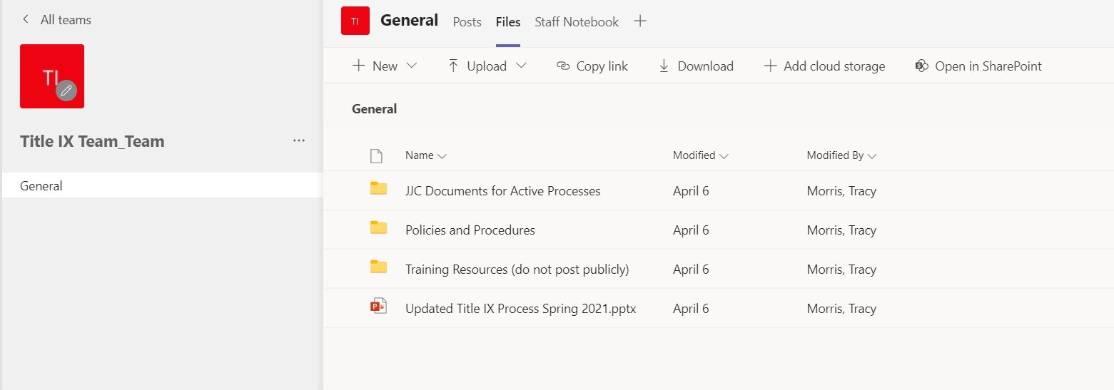
Teams Site

